Slide 1
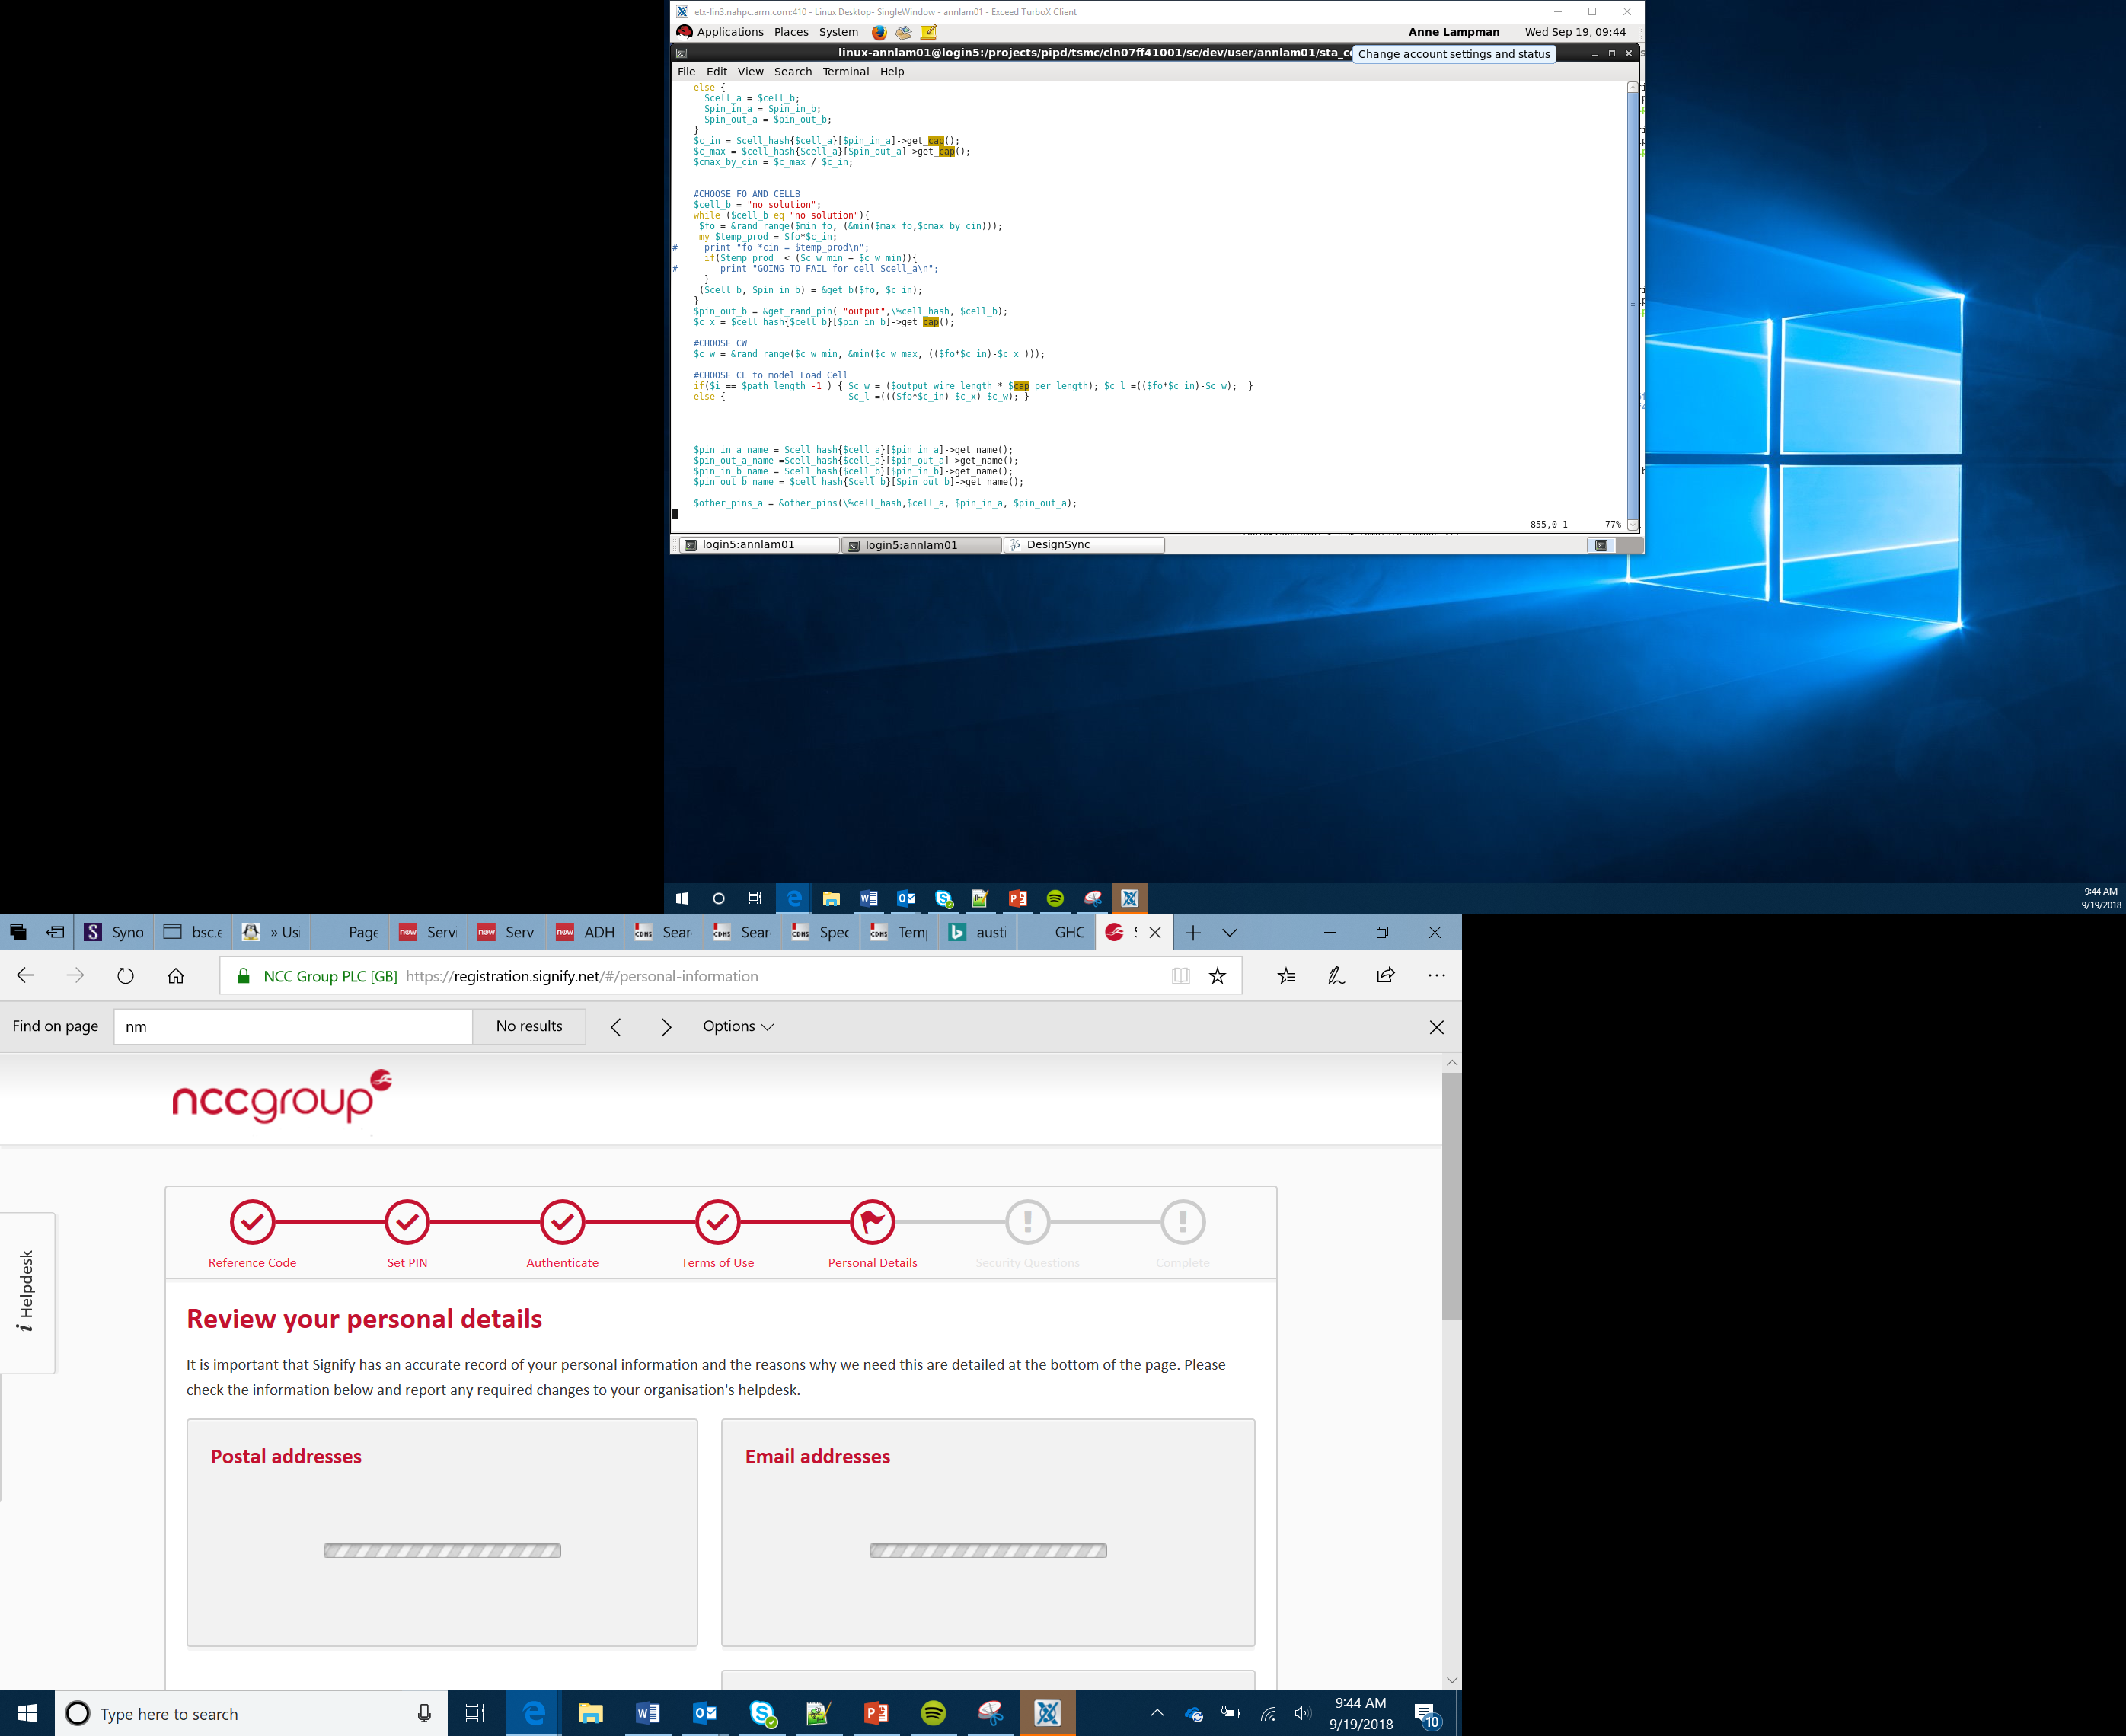

Sensors and Selection
Lesson 7

Slide 2
Sensors
Sensors allow a computer to detect certain measurements
The measurements from a sensor will be processed and the micro:bit program can make decisions based on the value
Sensors can be analogue or digital
Digital sensors can only detect a single status, for example if a temperature is above 50ºC or not – they display the result as either a 1 or a 0
Analogue sensors continually measure values within a range
Notes:
Use examples to show difference between Analogue and digital sensors. Digital sensors are like switches – either on or off – eg door sensors in an alarm system. Analogue sensors measure continuously like a speed or temperature sensor. The program may make a digital system based on analogue data – it changes what it does if an analogue value is larger than a given value.

Slide 3
Types of Sensor
Different sensors can detect different things
You are going to develop a temperature sensor on a micro:bit
In addition to temperature sensors there are a range of different sensors which can detect different things
Complete the ‘Sensing Your World’ worksheet, use the internet to help you
Notes:
Perhaps use the m

Slide 4
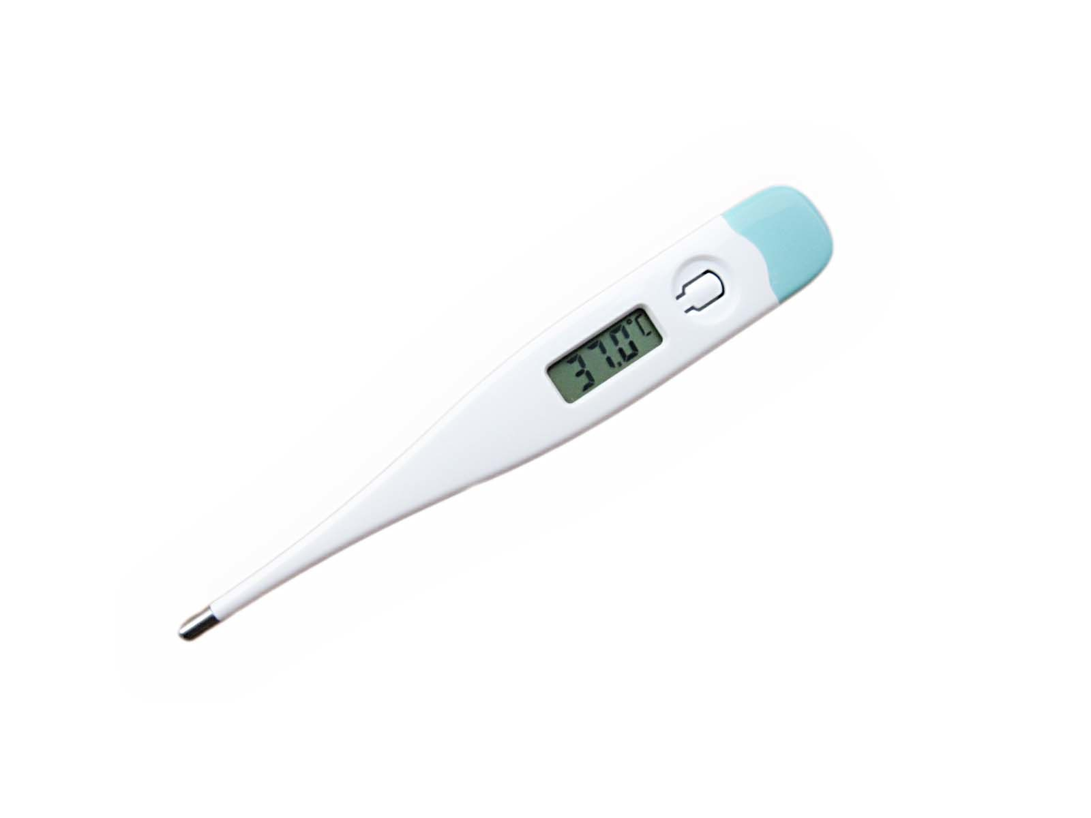
Temperature Sensor
A temperature sensor can be used to measure how hot or cold an object is
Temperature sensors have two different types of metal which conduct an electrical charge between them
As the temperature increases so does the electrical charge between the two metals
This voltage is measured and converted into the temperature in degrees
This Photo by Unknown Author is licensed under CC BY-SA

Slide 5
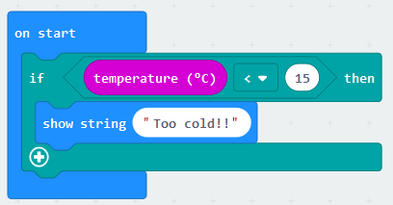
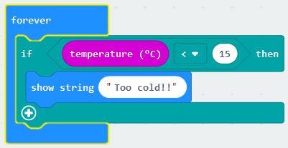
Endless Loops
If you program a micro:bit to detect the temperature it is important that it does this continuously – we could use the following code:
The code above would work initially but it would stop detecting the temperature once it had initially been measured
As we want it to continuously measure the temperature we need to include it in a forever loop - an endless loop:

Slide 6
Program Flow Discussion
Do computer programs always take the same route through the code?
When code is run line by line, in the same order every time this is known as sequence or program flow
Notes:
Draw out from learners that someone code will only need to be run if a certain condition is true. You may want to ask learners to think back to the maths program which they completed on the micro:bit. The question appeared when they pressed Button A whereas the answer appeared when they pressed Button B. Different code was run depending on different conditions.

Slide 7
Program Flow
There will be times when a computer program will only need to do a certain task if a condition is true
For example, think about getting dressed – what could cause you to dress differently?

Slide 8
Getting Dressed Algorithm
Depending on the weather you may wish to dress differently. If we were to write this as an algorithm using a flow chart what shape would we use for a decision?
Our basic getting dressed algorithm could look like this:
As you can see from the flow chart:
You would only put on trousers if it is not warm
You would put on shorts if it is warm, taking a different route through the decision
Start
Is it warm?
No
Put on trousers
Yes
Put on shorts
End

Slide 9
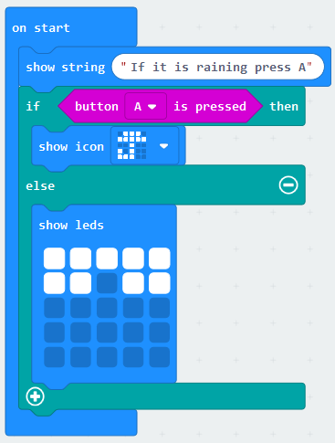
The micro:bit – If Then Else
If then else statements on the MakeCode website appear in the logic group, for example:
If Button A is pressed and held down
Then the icon of an umbrella will be shown
Else (ie If Button A isn’t pressed) an icon of a pair of sunglasses will be displayed
A different route is taken through the program depending on if the Button A is pressed or not
Try to create your own program in MakeCode using at least one if, then, else statement

